Slide 1

3.2 Determining if a subset is a subspace

Slide 2
Introduction
In this topic, we will
  Describe the idea of a subspace
  Consider a few examples, including in R² and R³
  Prove a few theorems regarding such subspaces
  Consider all linear combinations of a finite set of vectors

Slide 3
The zero set
Given R², let us focus on the set containing just the zero vector:
Notice that:
  If we add any two vectors in S, we get back a vector in S:
    0 + 0 = 0
  If we multiply any vector in S by a scalar, we get back a vector in S:
  α 0 = 0
Thus, S is closed under vector addition and scalar multiplication
  Any subset of a vector space that is closed under vector addition
  and scalar multiplication is said to be a subspace of that vector space

Slide 4
The entire vector space
Another subset of R² is all of R²
  Given any vector space V, we call both {0} and V the trivial
  subspaces of V

Slide 5
The empty set
The empty set is a subset of R²
  Is it a subspace?
Recall that for a set to be a vector space,
it must have a zero vector
  The empty set does not have a zero vector,
  thus, it is not a subspace

Slide 6
When is a subset a subspace?
A subset S of a vector space V is itself a vector space if:
  The sum of any two vectors in S is again a vector in S
  All scalar multiples of a vector in S must again be vectors in S
In this case, S is a vector space
  Because it is a subset of the vector space V ,
  it is called a subspace of the vector space V

Slide 7
When is a subset a subspace?
Consider the vector space of all polynomials with
real coefficients: R[x]
  Previously, we described how this is a vector space
Consider the subset S₅ of all polynomials of degree less than
or equal to 5
  Multiplying a polynomial of degree less than or equal to 5 by α
  must result in a polynomial of degree less than or equal to 5
  Adding two polynomials of degree less than or equal to 5
  must result in a polynomial of degree less than or equal to 5
Therefore, S₅ must be a vector space,
thus, it is a subspace of R[x]

Slide 8
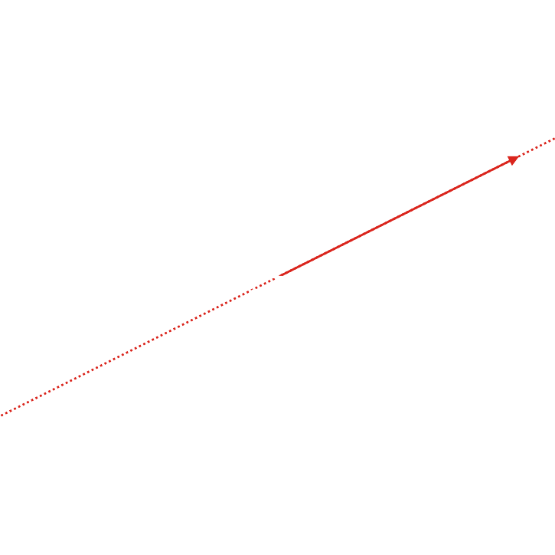
Discrete signals
In R², consider all scalar multiples of
  This is a line in 2-space
  passing through the origin

Slide 9
Discrete signals
For example, is such a vector
  We see that , so
  Now, if
  note that

Slide 10
Straight lines in R²
For example, and are such vectors
We see that and
  We also see
  Thus, the sum of these two vectors on
  this line is still on this line

Slide 11
Straight lines in R²
Theorem
If V is any vector space, and ,
then the subset S of all scalar multiples of u
is a subspace of V.
Proof:
If , then for some β.
Thus, , so .
If , then and for some β₁ and β₂.
Thus, , so . .
Therefore, all scalar multiples of u for a subspace of V. ▮

Slide 12
Straight lines in R²
Thus, any “line through the origin” in any vector space is a subspace:
  Given R[x], the vector space of all polynomials
  Note that
  Thus, all scalar multiples α x² forms a subspace of R[x]

Slide 13
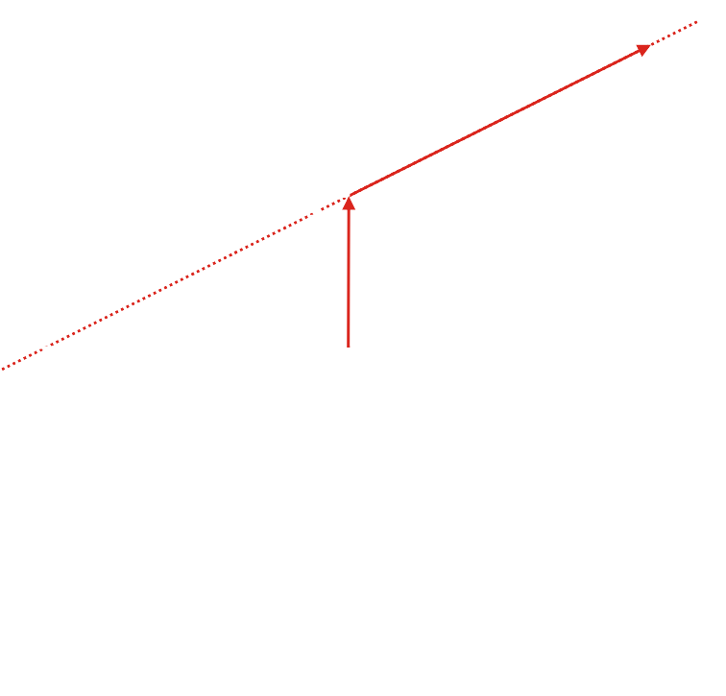
Straight lines in R²
What if the line does not pass through the origin?
  Consider all vectors of the form
  The vector is on this line
  Problem: is not
  Therefore, this is not a subspace

Slide 14
Subspaces must contain the origin
Theorem
Given a vector space V, any subset that does not
contain the zero vector is not a subspace of V.
Proof:
If S = {}, we have already shown it is not a subspace.
If S ≠ {}, then S must have at least one vector u,
and by assumption, u ≠ 0.
However, 0u = 0, and thus,
S is not closed under scalar multiplication.
Therefore S cannot be a subspace. ▮

Slide 15
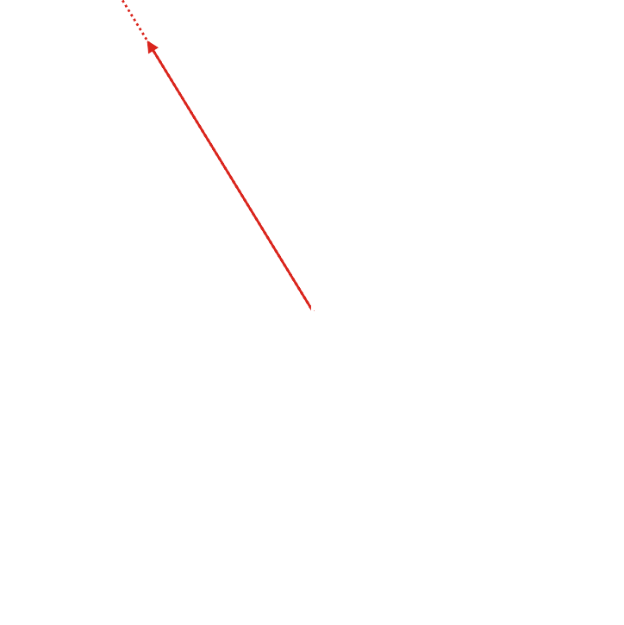
Rays from the origin
Consider the set T of all non-negative multiples of a vector u
  This forms a ray coming out of the origin
If , then and
for α₁ ≥ 0 and α₂ ≥ 0.
  Therefore,
  where α₁ + α₂ ≥ 0.
  Thus, T is closed under vector addition.
However, , a scalar multiple of a vector
in T is not in T
  Thus, T is not closed under scalar multiplication.

Slide 16
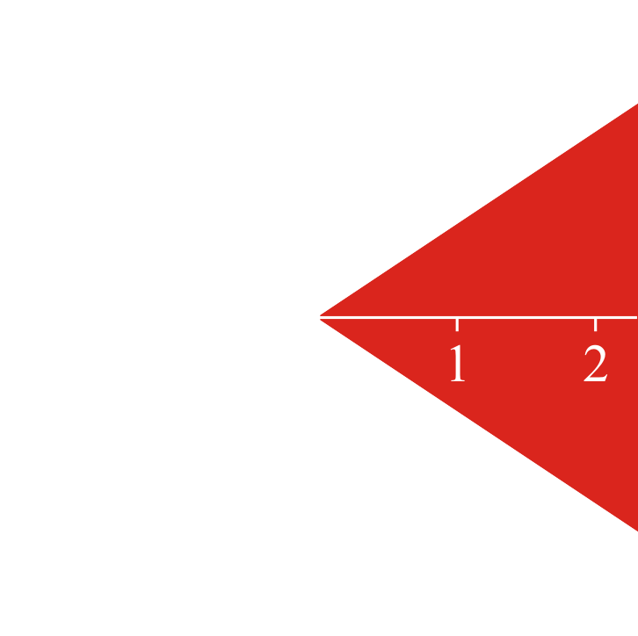
Cones
Is the region in red a subspace of R²?
  If we add two vectors in this cone,
  the sum is still in the cone
  If we multiply any vector in this cone by –1,
  apart from 0, the product is not in the cone

Slide 17
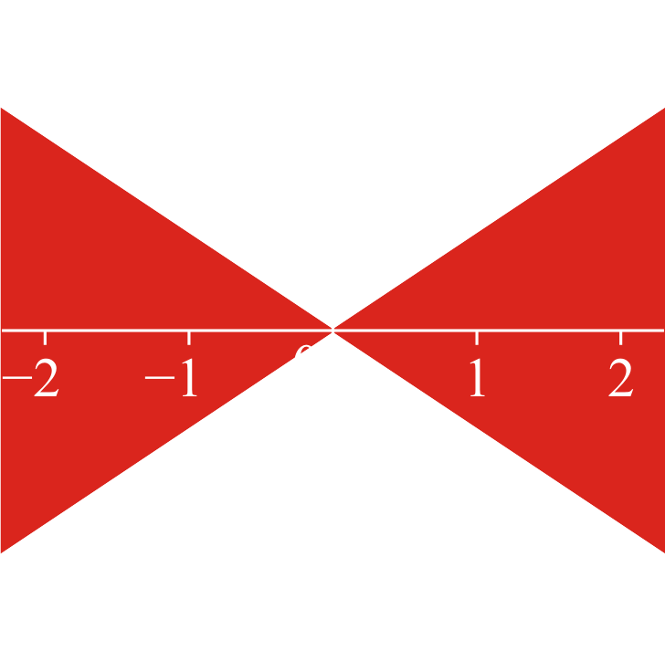
Cones
Let’s add all scalar multiples of all vectors in this cone
  Is this now a subspace?
    It is definitely closed under scalar multiplication
    Unfortunately, try adding:

Slide 18
Cones
Given any vector in R², we can find it to be the sum of two
vectors in this double cone:
Thus, the smallest subspace
containing this double
cone is all of R²

Slide 19
All subspaces of R²
Thus, all subspaces of R² include:
  The trivial subspace
  All lines passing through the origin
  The trivial subspace R²

Slide 20
Linear combinations
Theorem
Given a finite set of m vectors in some vector
space V , the set S of all scalar multiples of these vectors,
,
forms a subspace.
Proof:
  Any vector in this set is of the form
  Thus,
  Also,
  Therefore, S is a subspace of V. ▮

Slide 21
Linear combinations
Claim: For all finite-dimensional vector spaces R^{n} and C^{n},
the only subspaces are {0} or all linear combinations
of one or more non-zero vectors

Slide 22
Linear combinations
For example, in R³
  There is the subspace containing the zero vector
  Given a non-zero vector u,
  all linear combinations of u forms a line through the origin
  If two non-zero vectors are not scalar multiples of each other,
  all linear combinations of u₁ and u₂ forms a plane through the origin

Slide 23
Linear combinations
For any other description of a subset of a vector space,
to show it is a subspace, you must show that:
  All scalar multiples of one vector that fit that description,
  must still fit that description
  The sum of any two vectors that fit that description,
  must still fit that description
Note that if the zero vector does not fit the description,
you may automatically conclude that the subset is not a subspace
  We’ll look at a few examples next

Slide 24
Summary
Following this topic, you now
  Understand the idea of a subspace
  Know that subspaces must contain the zero vector
  Are aware that all subspaces of F^{n} are the result of taking all linear combinations of a finite set of vectors
    E.g., all non-trivial subspaces of R³ in include all lines and planes that pass through the origin
  Know that to prove a subset is a subspace, you must
  show it is closed under vector addition and scalar multiplication

Slide 25
References
[1] https://en.wikipedia.org/wiki/Linear_subspace

Slide 26
Acknowledgments
None so far.

Slide 27



Colophon
These slides were prepared using the Cambria typeface. Mathematical equations use Times New Roman, and source code is presented using Consolas.
The photographs of flowers and a monarch butter appearing on the title slide and accenting the top of each other slide were taken at the Royal Botanical Gardens in October of 2017 by Douglas Wilhelm Harder. Please see
https://www.rbg.ca/
for more information.

Slide 28
Disclaimer
These slides are provided for the ne 112 Linear algebra for nanotechnology engineering course taught at the University of Waterloo. The material in it reflects the authors’ best judgment in light of the information available to them at the time of preparation. Any reliance on these course slides by any party for any other purpose are the responsibility of such parties. The authors accept no responsibility for damages, if any, suffered by any party as a result of decisions made or actions based on these course slides for any other purpose than that for which it was intended.

